Slide 1
IM Scavenger Hunt
Loading...

Slide 2
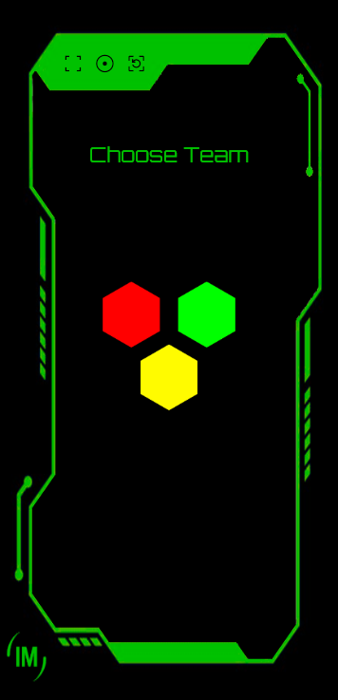
IM Scavenger Hunt
This is your gadget
To access go to
reading-scavenger-hunt.NetlifY.app

Slide 3
IM Scavenger Hunt
Once accessed select your team
Red, Green or yellow
By tapping on the appropriate hexagon
Only one gadget is allowed per team

Slide 4
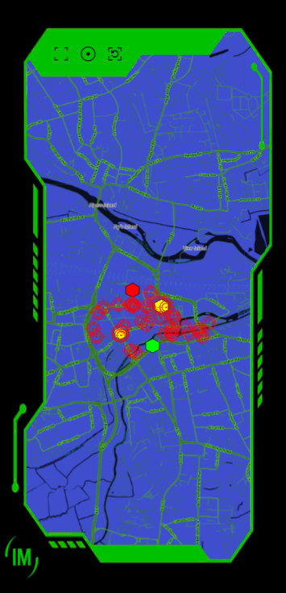
IM Scavenger Hunt
After you have selected your team
Your gadget will display a map
Note the three symbols on the top left:
this makes the gadget fill the screen
this centres the map on your location
this reloads the gadget

Slide 5
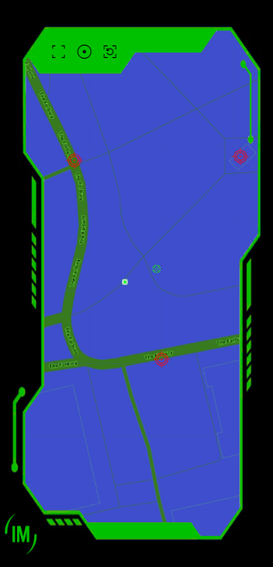
IM Scavenger Hunt
This green dot is your location
The dark blue circle around the dot indicates how accurately the gadget has tracked your location
A wide circle is inaccurate
A small circle is very accurate

Slide 6
IM Scavenger Hunt
This red target is a datapoint
If you are close enough to a datapoint you can tap it and a question will appear

Slide 7
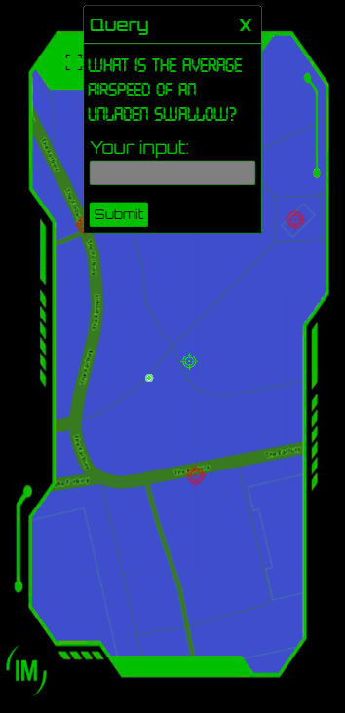
IM Scavenger Hunt
The answer to every datapoint query is a number
You will need to look around the area at or near the datapoint to find the answer.
Some answers will require very basic maths.
All datapoints are located outside (except one)
Type your answer in the grey box and hit submit.
If correct your team will capture the datapoint.

Slide 8
IM Scavenger Hunt
For a datapoint to display a question you need to be physically close enough to the location (within approximately 20 metres)
Datapoints are marked by different icons depending on their status

Slide 9





IM Scavenger Hunt
A datapoint you can access will be marked by a pulsing green target – you are close enough and can tap on it
A datapoint you cannot access will be marked by a fixed red target – you are too far away, move closer
A datapoint first captured by the yellow team
A datapoint first captured by the red team
A datapoint first captured by the Green team

Slide 10
IM Scavenger Hunt
Just because another team first captures a datapoint does not mean you cannot still access it.
The first team to capture a datapoint gets the highest score from that datapoint. The second team gets 50% and the third team gets 25%
The further away or harder to spot the higher the potential score from the data point.

Slide 11


IM Scavenger Hunt
A datapoint marked by a static, coloured hexagon has been captured by your team. But the hexagon will display the colour of the first team to capture the datapoint point
A pulsing hexagon with a green circle has been captured by another team but can be accessed by you - you are close enough to tap on it and answer the question
A static hexagon with a red circle has been captured by another team but can be accessed by you – however you are not close enough to tap on it – move closer

Slide 12
IM Scavenger Hunt
The team with the most points at the end – wins.
Simple really.
Your hunt master will be keeping a close eye on scores from central command.

